Slide 1
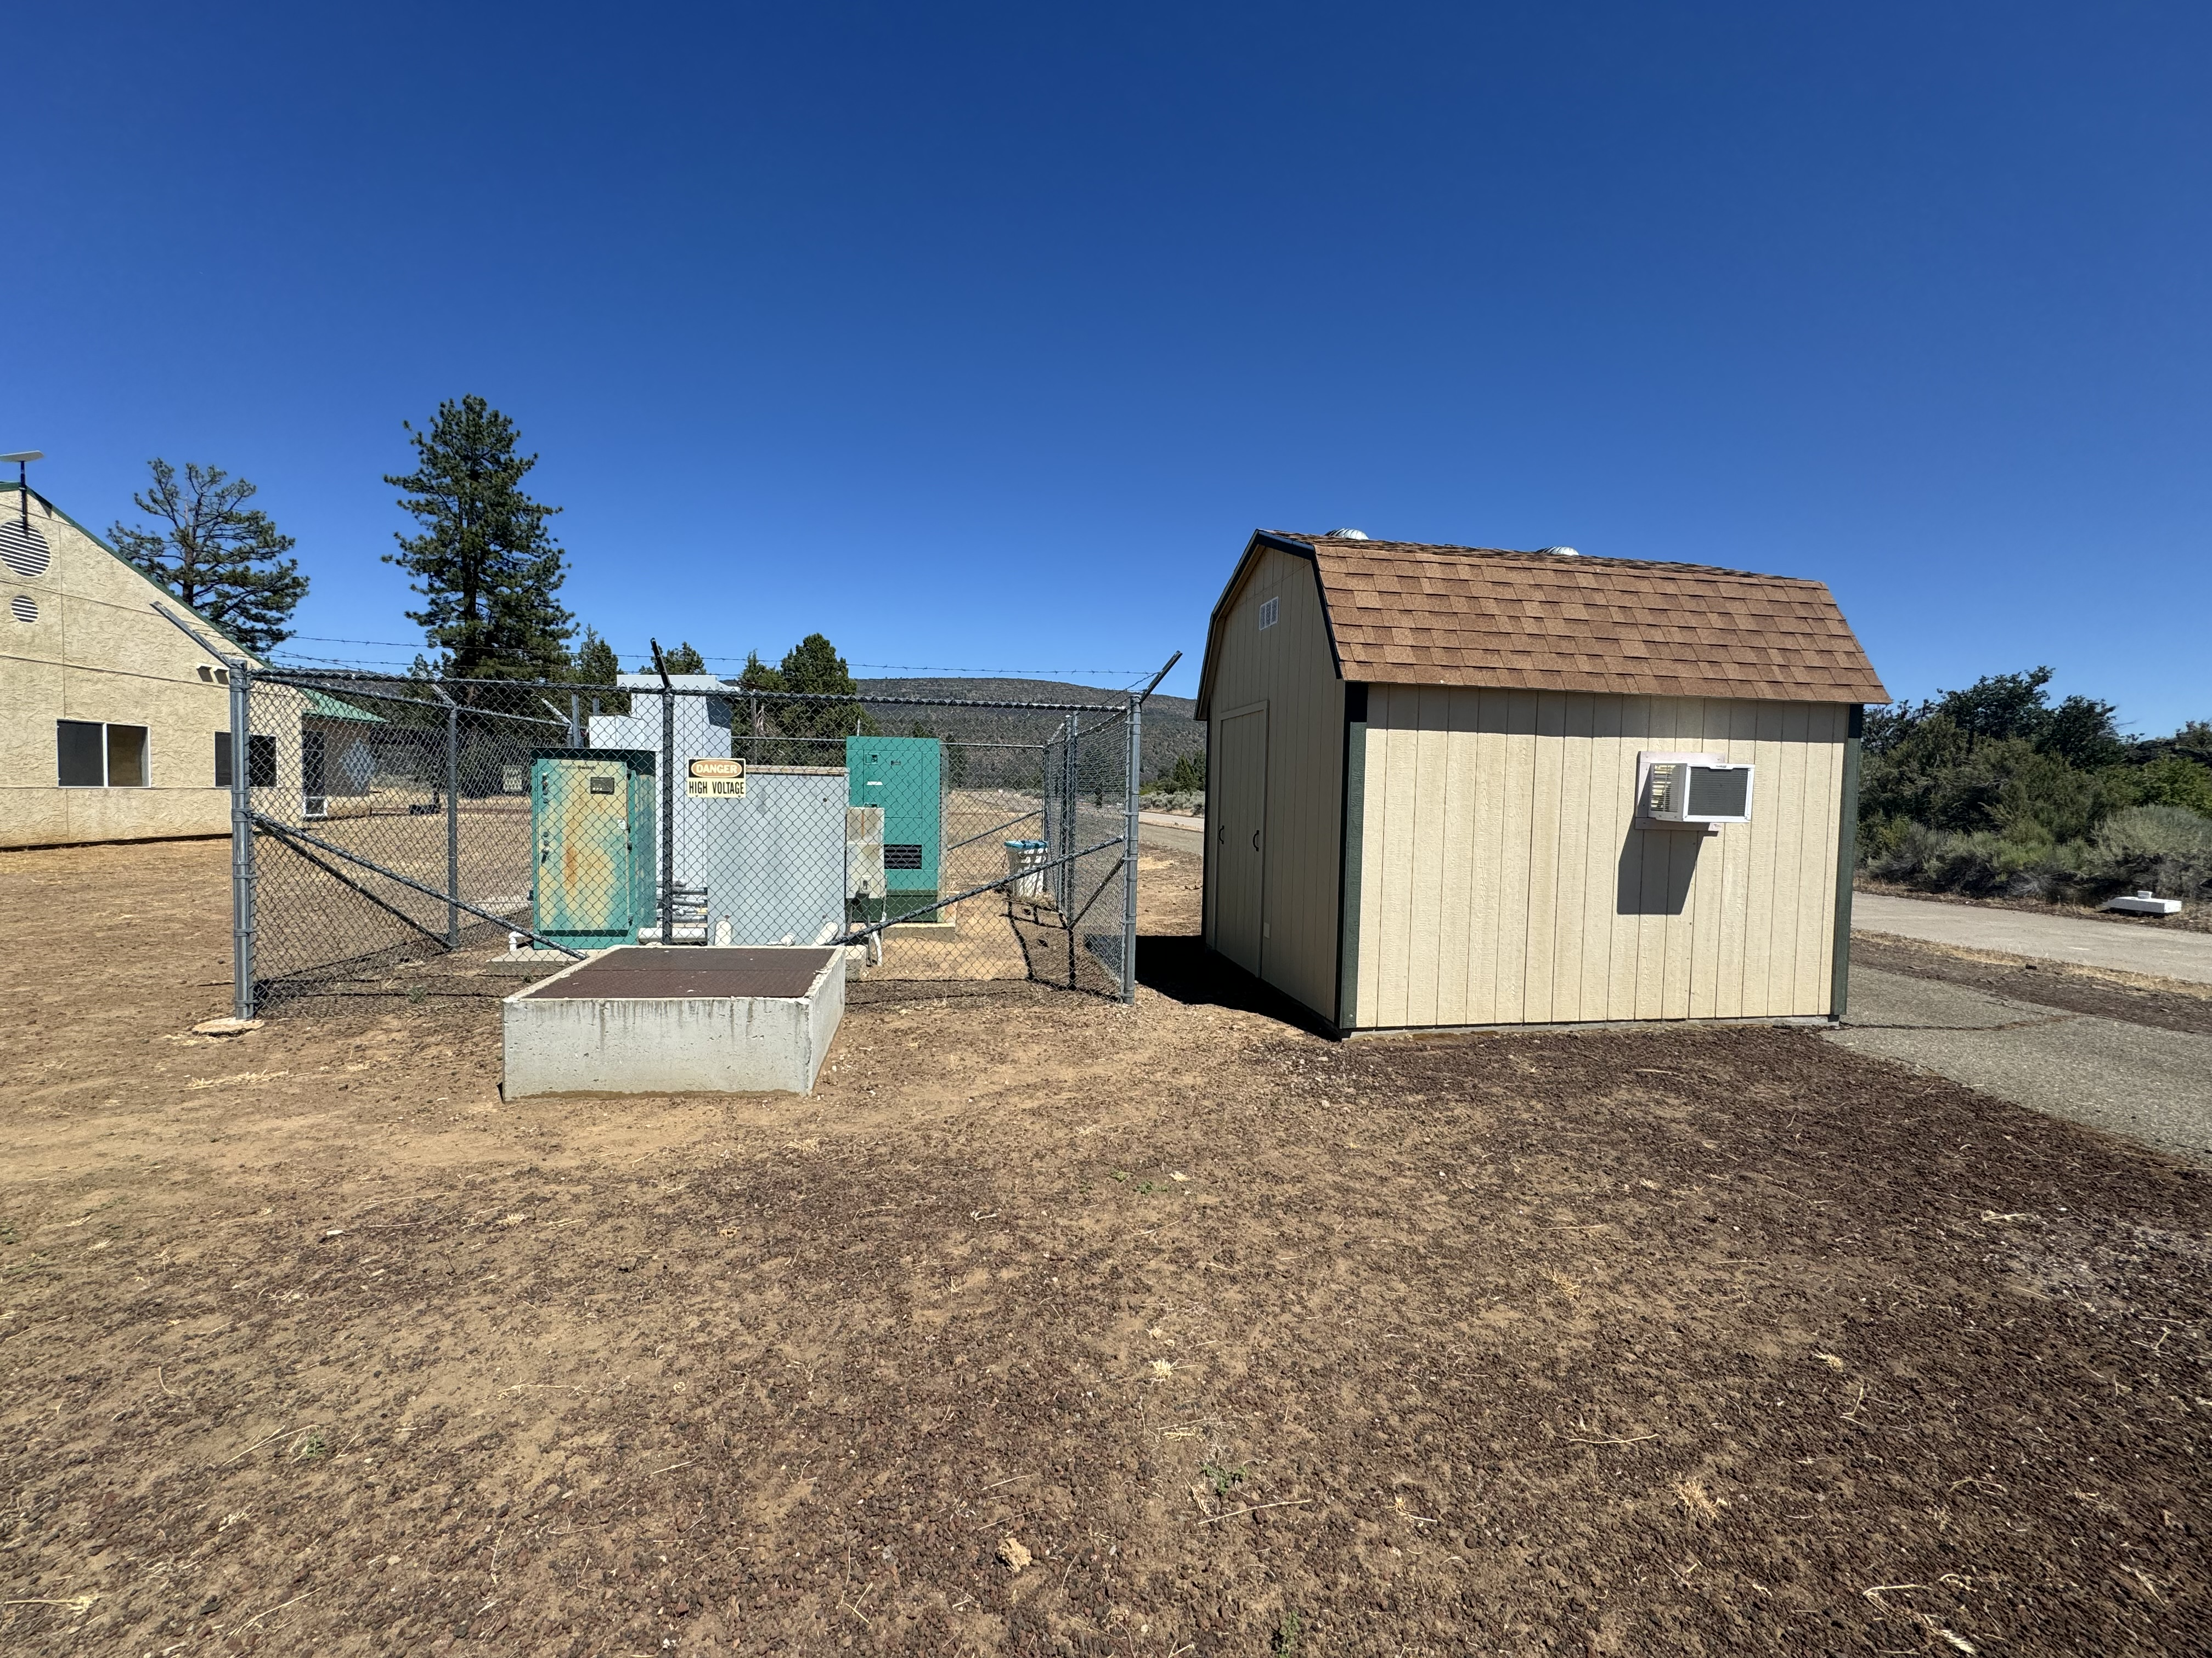
UPS shed
480V supply panel
old transformer
new existing concrete pad

Slide 2
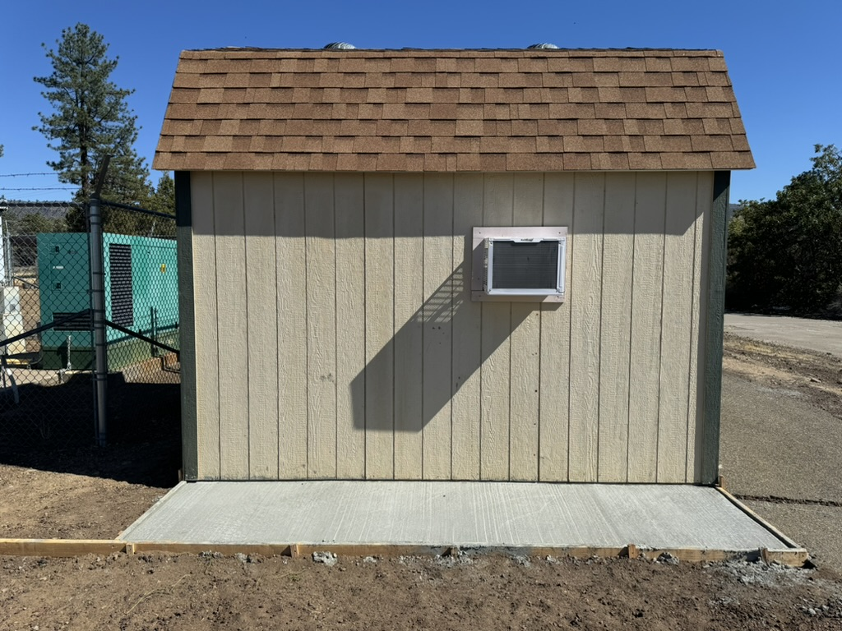
Old AC, will be removed
New outside unit for AC, supplied by another vendor
Circuit breaker panel, rated for outdoors
25KVA Transformer

Slide 3
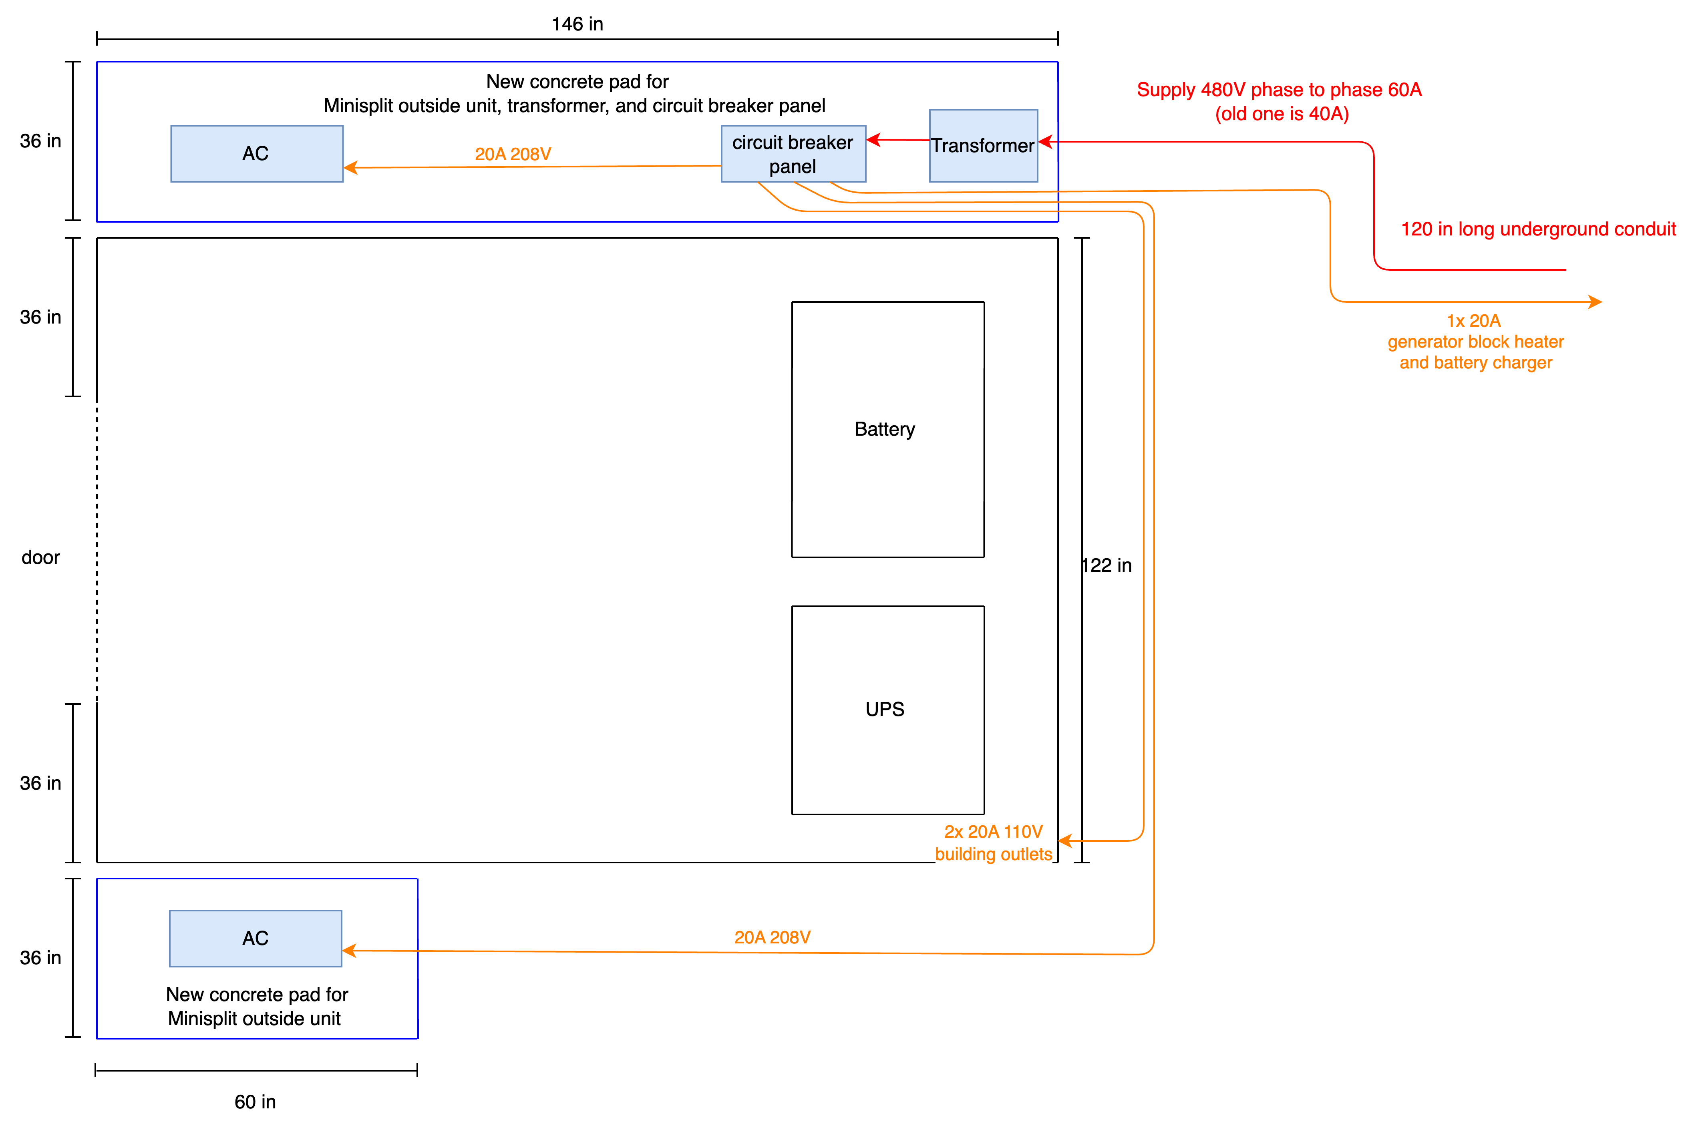

Slide 4
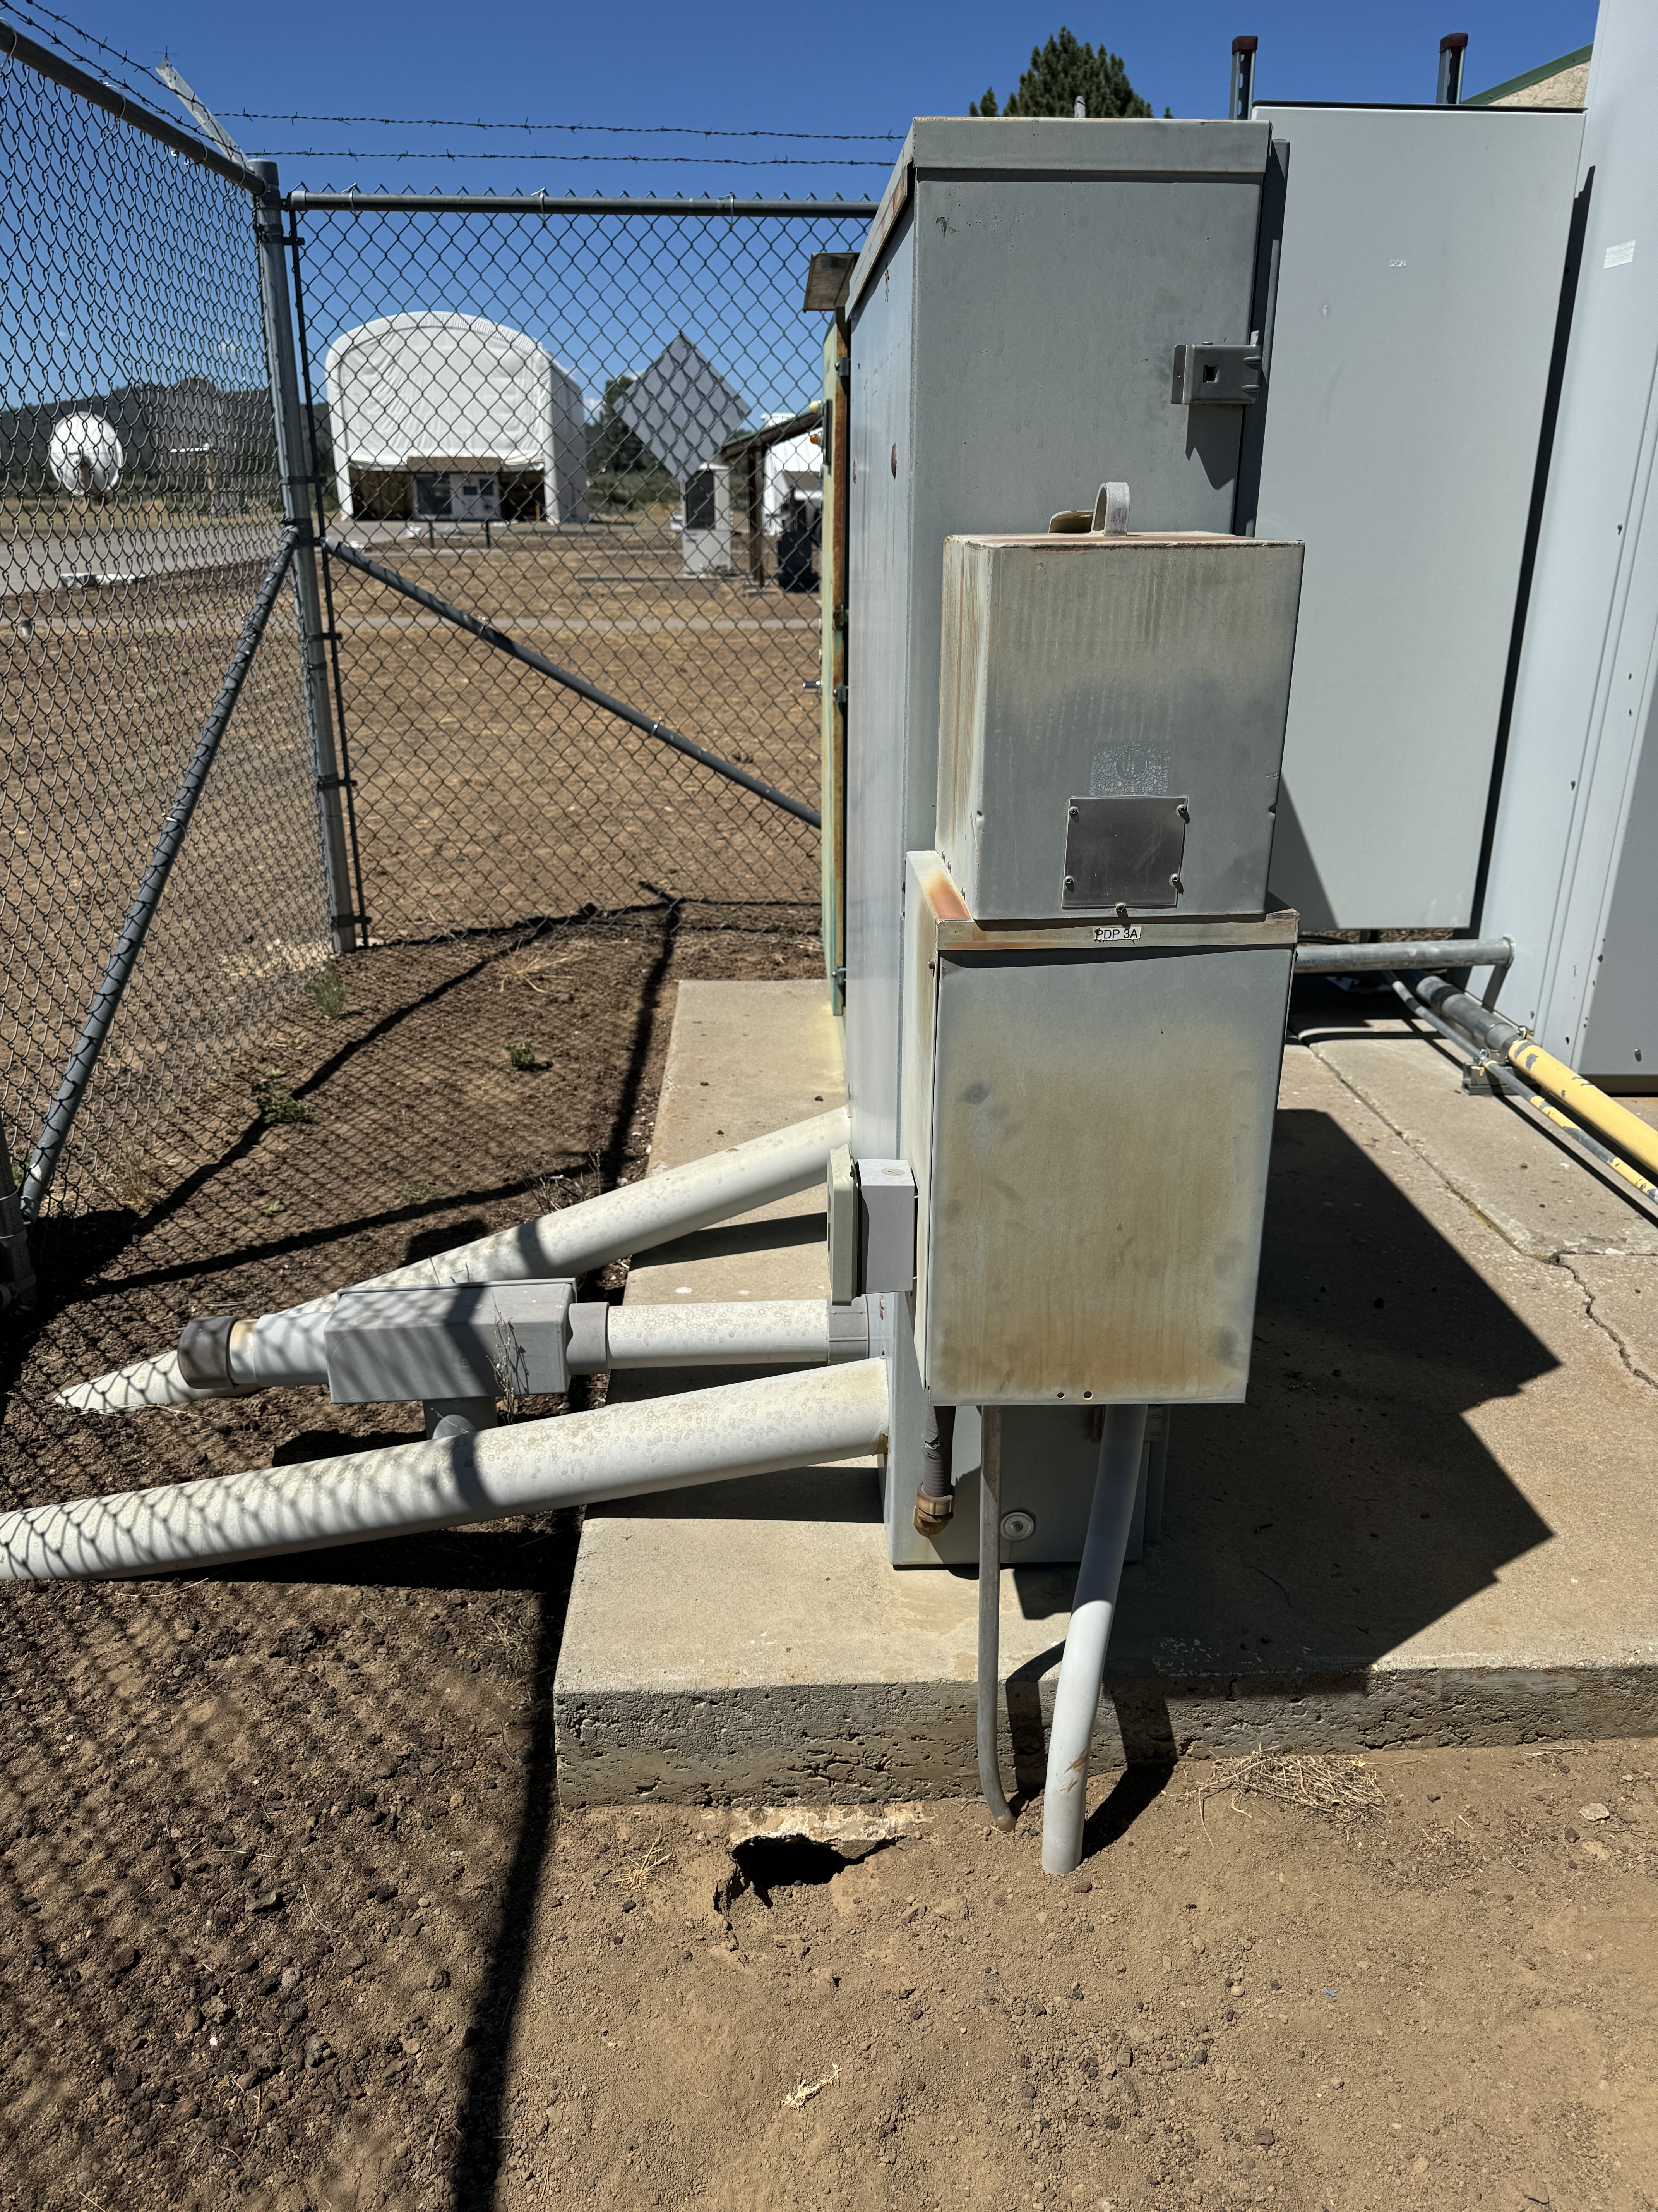
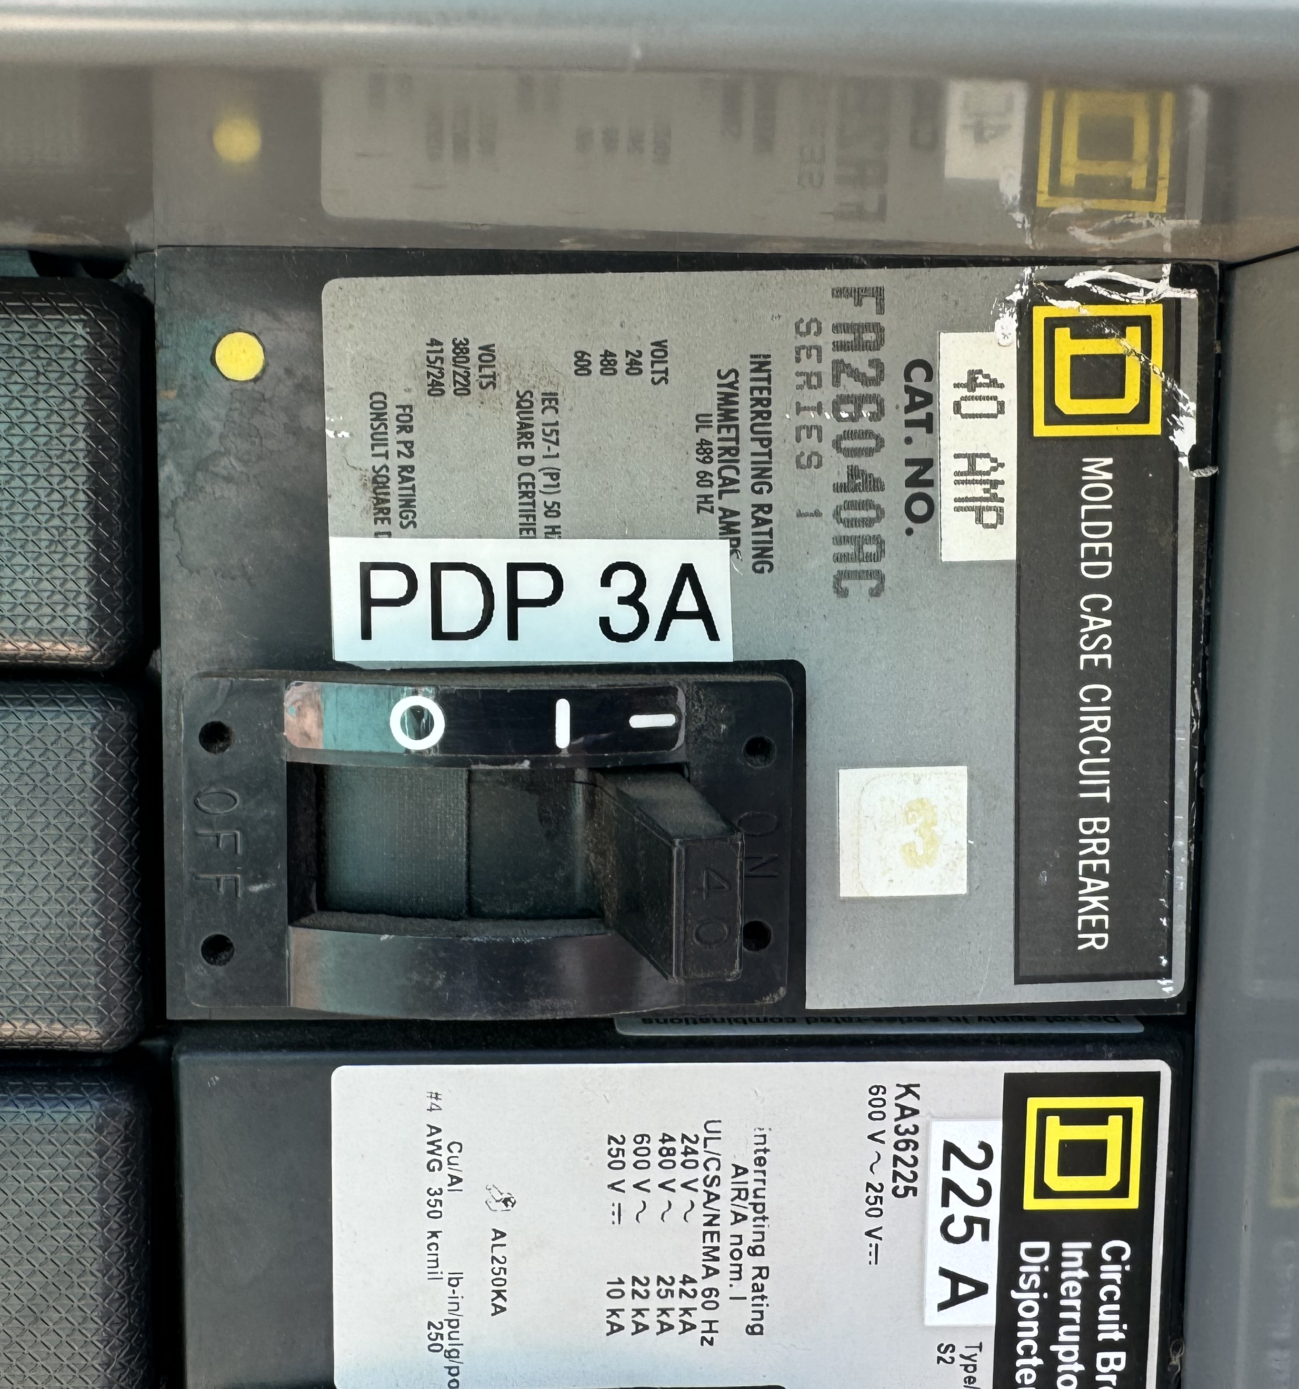
Supply panel PDP-3
breaker for transformer
480V supply panel
old transformer

Slide 5
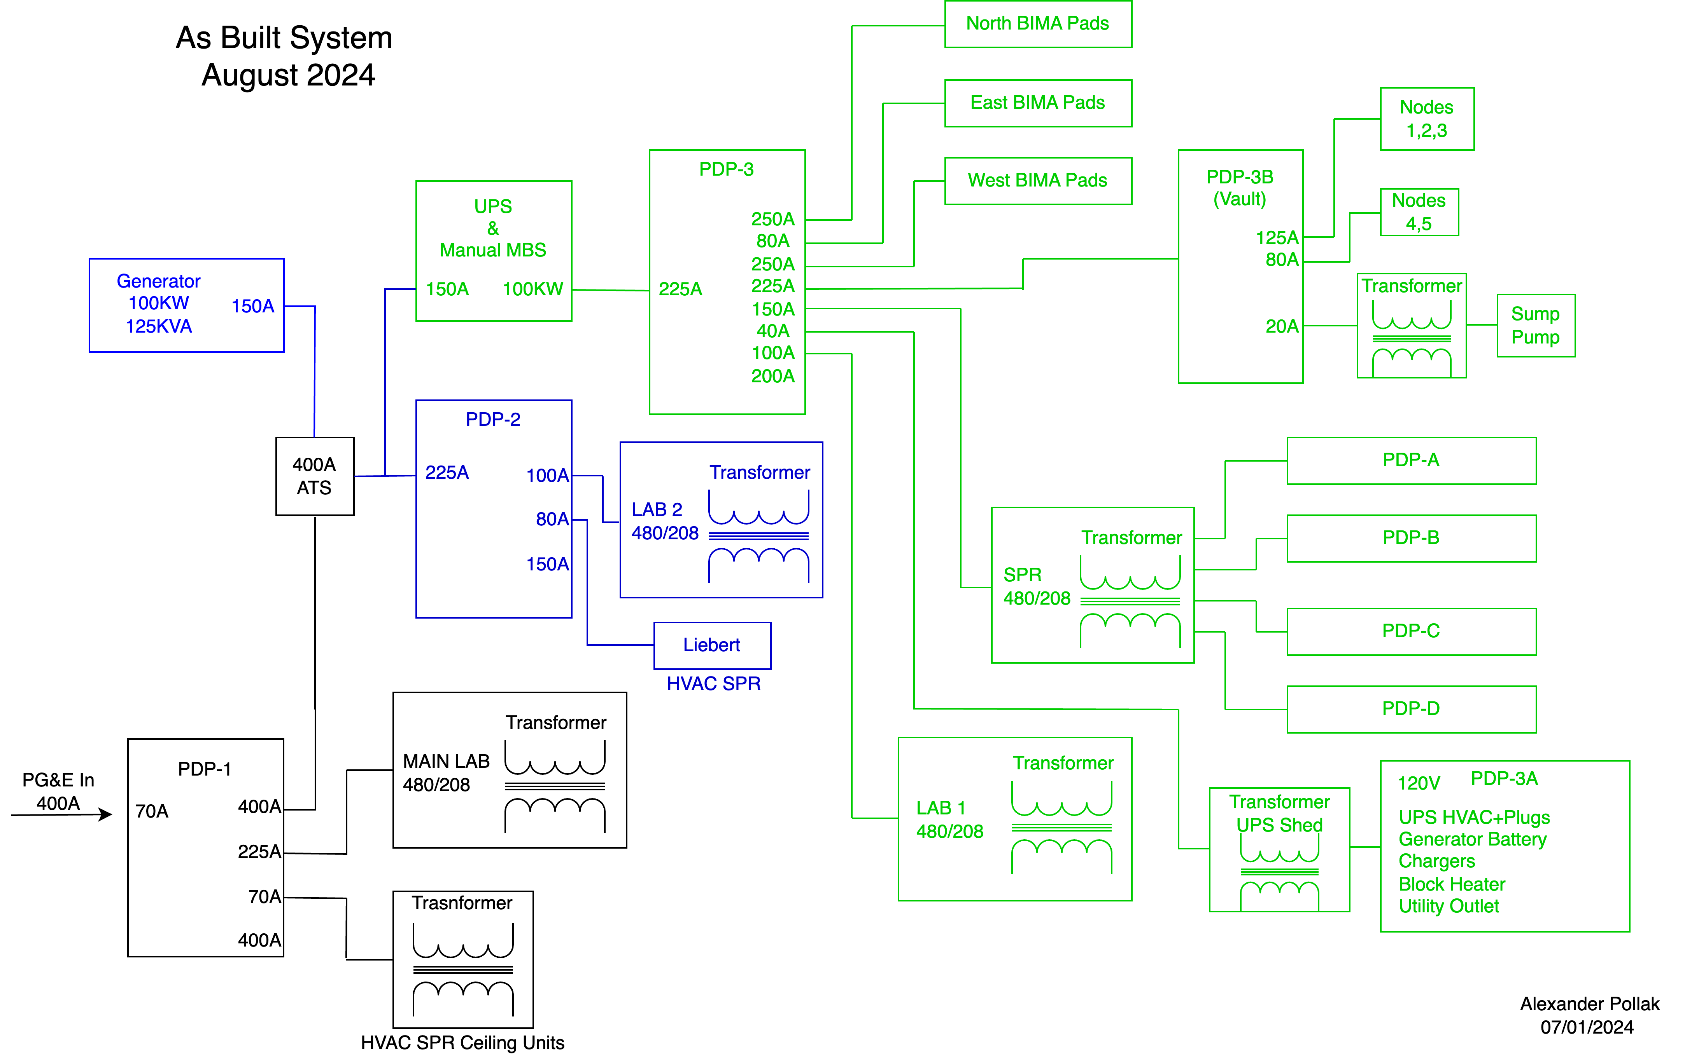
HCRO main power distribution
old transformer

